Slide 1
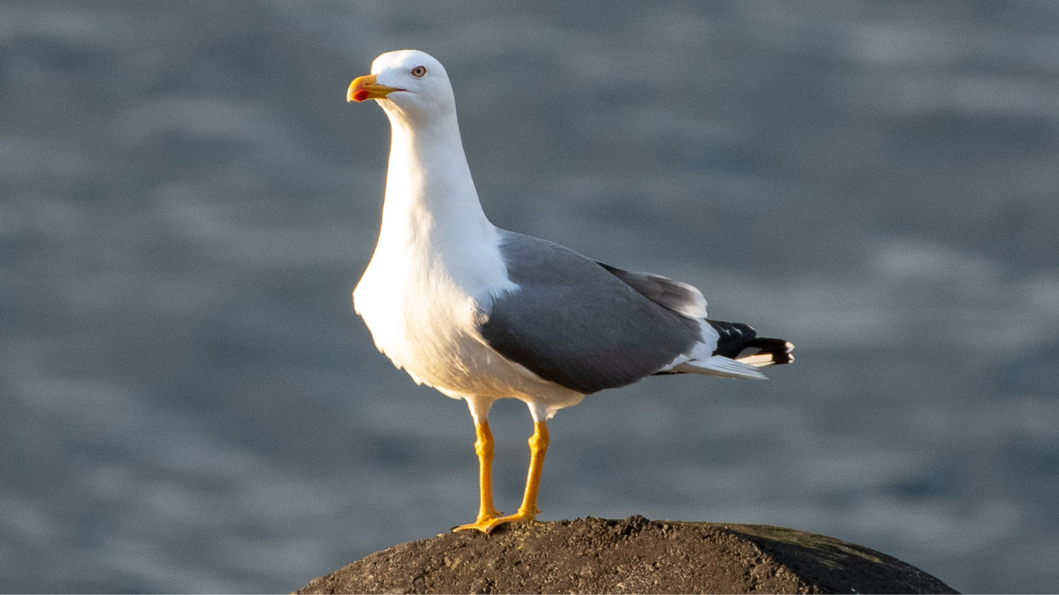
Using FLOSS to plan your daily exercise by birding!
By Richard Littauer!

Slide 2

Who is this Richard Littauer, anyway
Linguist and Latin tutor
Developer
"Community manager"
Currently: SustainOSS
Source not given

Slide 3
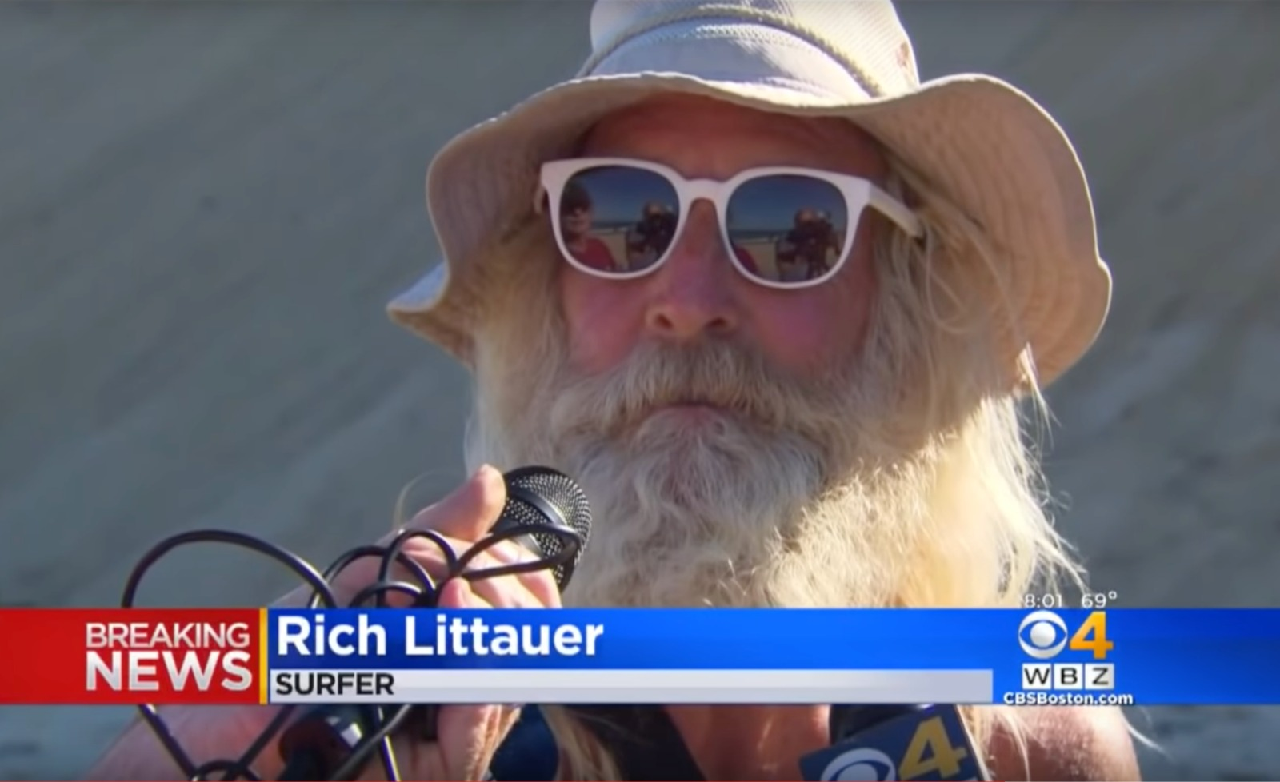
Who is this Richard Littauer, anyway
Washington county, Vermont birder
Unaffiliated ornithology academic
eBird reviewer for Ascension, St. Helena, Tristan da Cunha, and Addison County, VT
North Branch Nature Center board member (lapsed)
Sometime bird guide
iNaturalist contributor
Source not given

Slide 4
What is birding?
It is looking at things and naming them!
That's pretty much it!
Mainly avian things.

Slide 5

eBird?
This is a place to put lists of birds that you identified
It is not small.

Slide 6
Why bird?
Proven health benefits!
Exercise! (sort of)
Ties to your local community
A new understanding of the passing of time
Those sweet, sweet dopamine hits

Slide 7
Do I have to "list" birds?
No.
But lists can be useful for a few reasons!
They make you more attentive
They help Science!
They lead to gamification of the activity

Slide 8
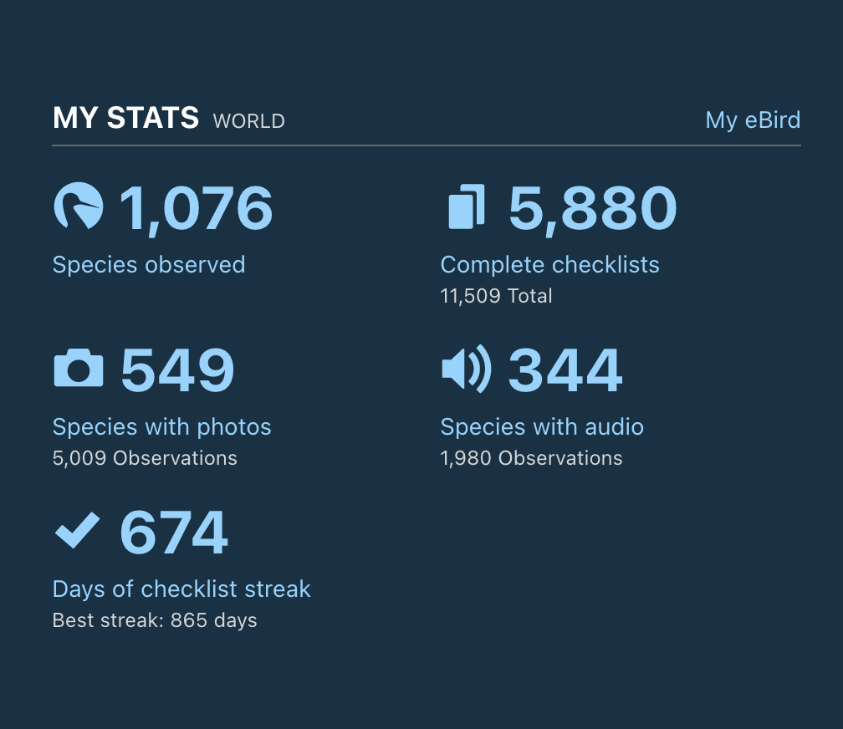
Gamifying birding?
Very yes.

Slide 9
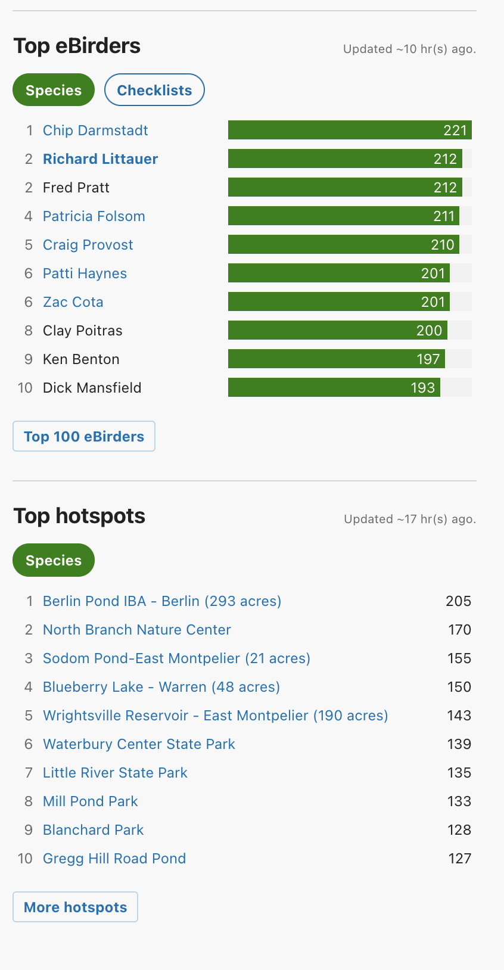
Gamifying birding?
Top eBirders for regions
Top "Hotspots"

Slide 10
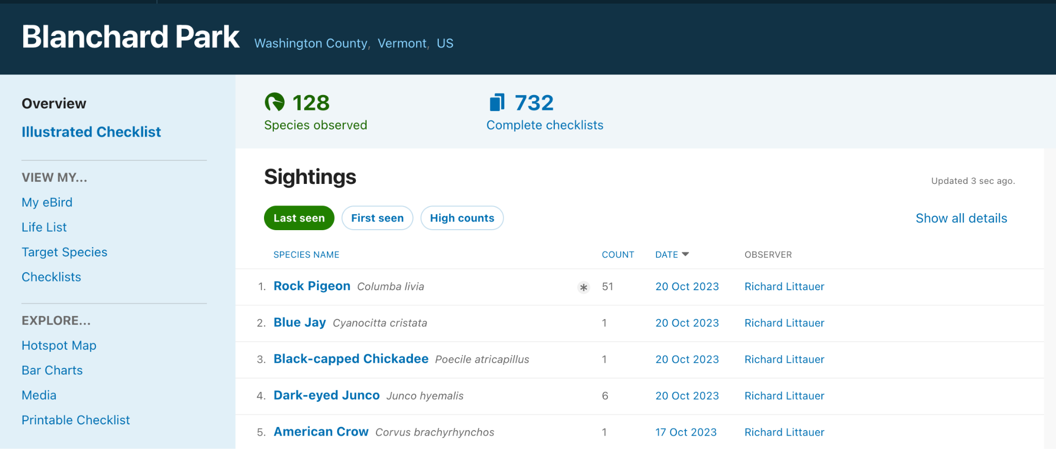
Gamifying birding?
Very yes.

Slide 11
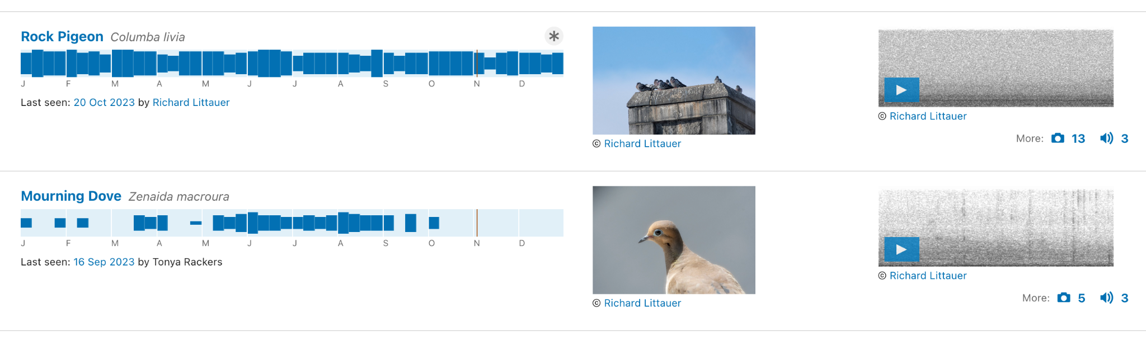
Illustrated checklists of hotspots!
See what birds are there, when.

Slide 12
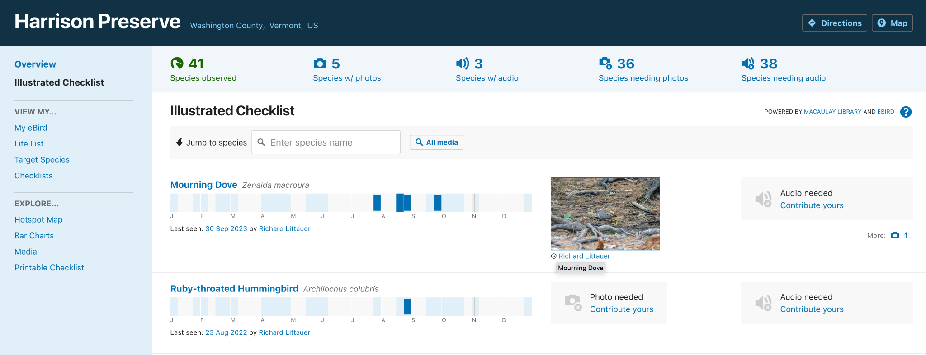
Illustrated checklists of hotspots!

Slide 13
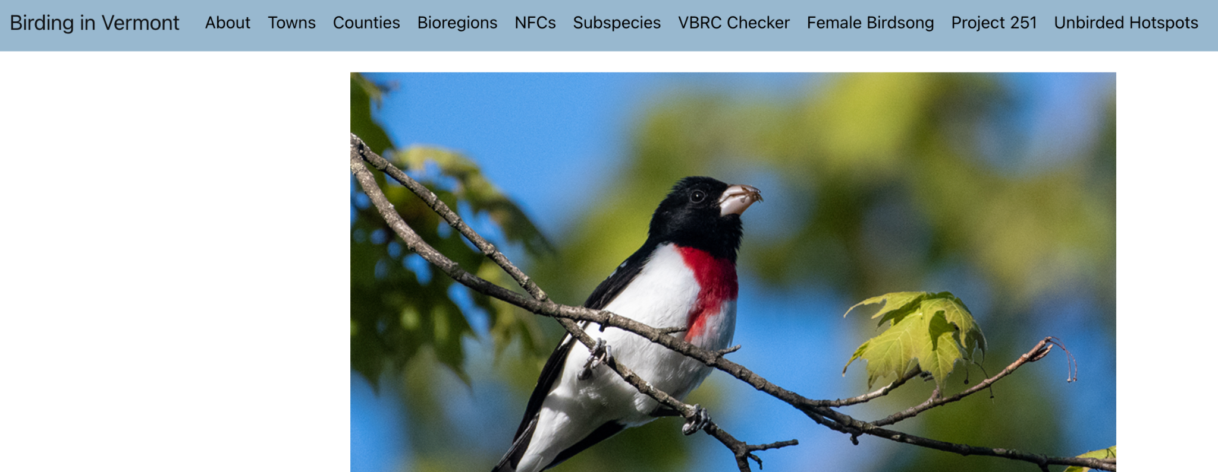
birdinginvermont.com

Slide 14
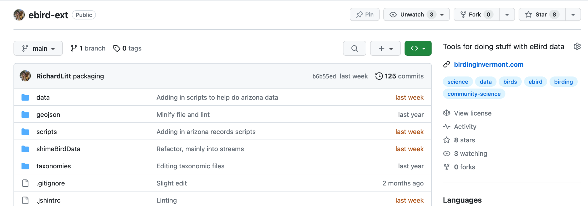
Ebird-ext tools!

Slide 15
An eBird script!
Goal: To know if a hotspot has been birded on any given week of the year.
Secondary: On any given day of the year.
With: Distance from my house, and coverage.

Slide 16
An eBird script! How it works.
Download eBird data
Shim it to JSON.
Use eBird API to get all hotspots in my area
Filter for that data only
Make an array of weeks and dates those hotspots have been birded

Slide 17
An eBird script! How it works.
```
#!/bin/bash
## Montpelier
/Users/richard/.nvm/versions/node/v14.15.5/bin/node /Users/richard/src/birding/birdinginvermont.com/src/ebird-ext/montpelier.js > /Users/richard/src/scripts/logs/hotspots.log
/Library/Frameworks/Python.framework/Versions/3.7/bin/python3 /Users/richard/src/scripts/emailNeeds.py
```

Slide 18
An eBird script! How it works.
Very simple email script: https://github.com/RichardLitt/scripts/blob/master/emailNeeds.py

Slide 19
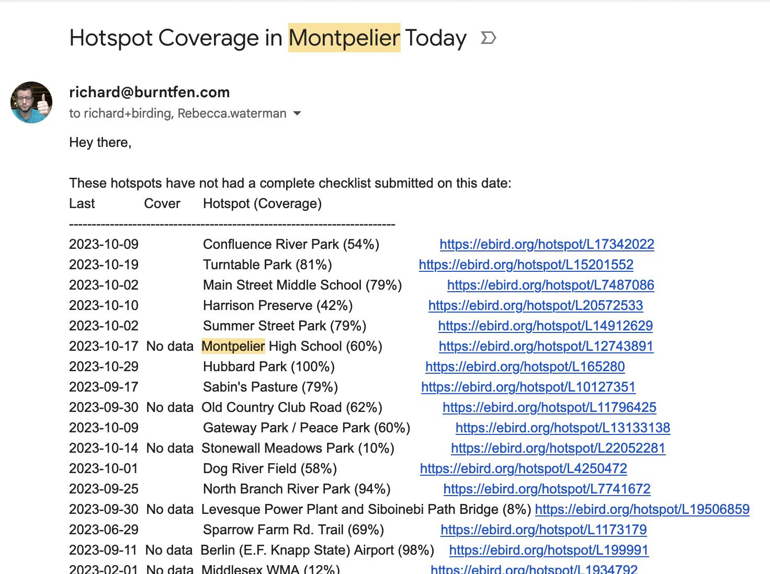
An eBird script! How it works.

Slide 20
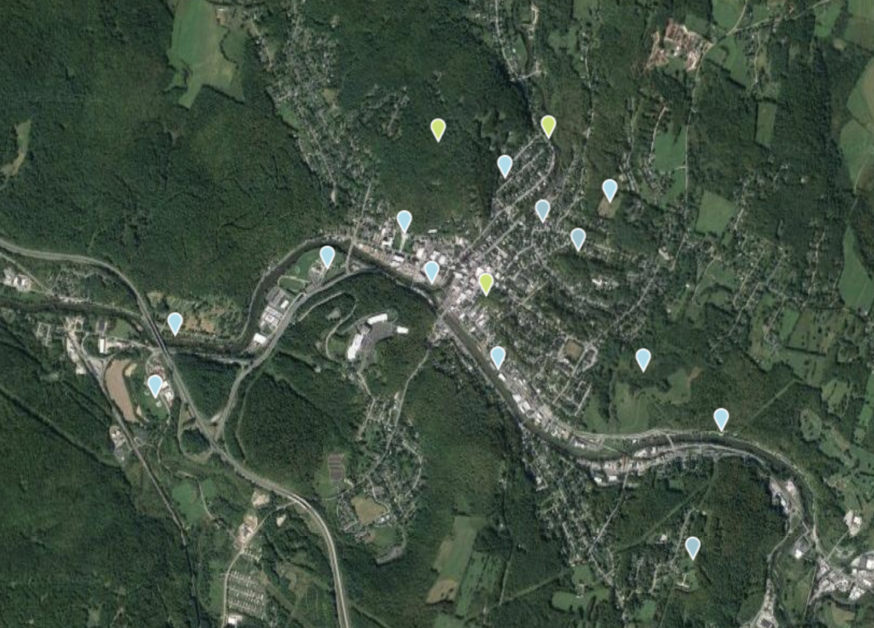

Slide 21
More more top hotspots:
See https://ebird.org/region/US-VT-023/hotspots?yr=cur

Slide 22
Does it help?
Yes!
More exercise
More science
More fun birding
More knowledge of local parks
Informs public policy

Slide 23

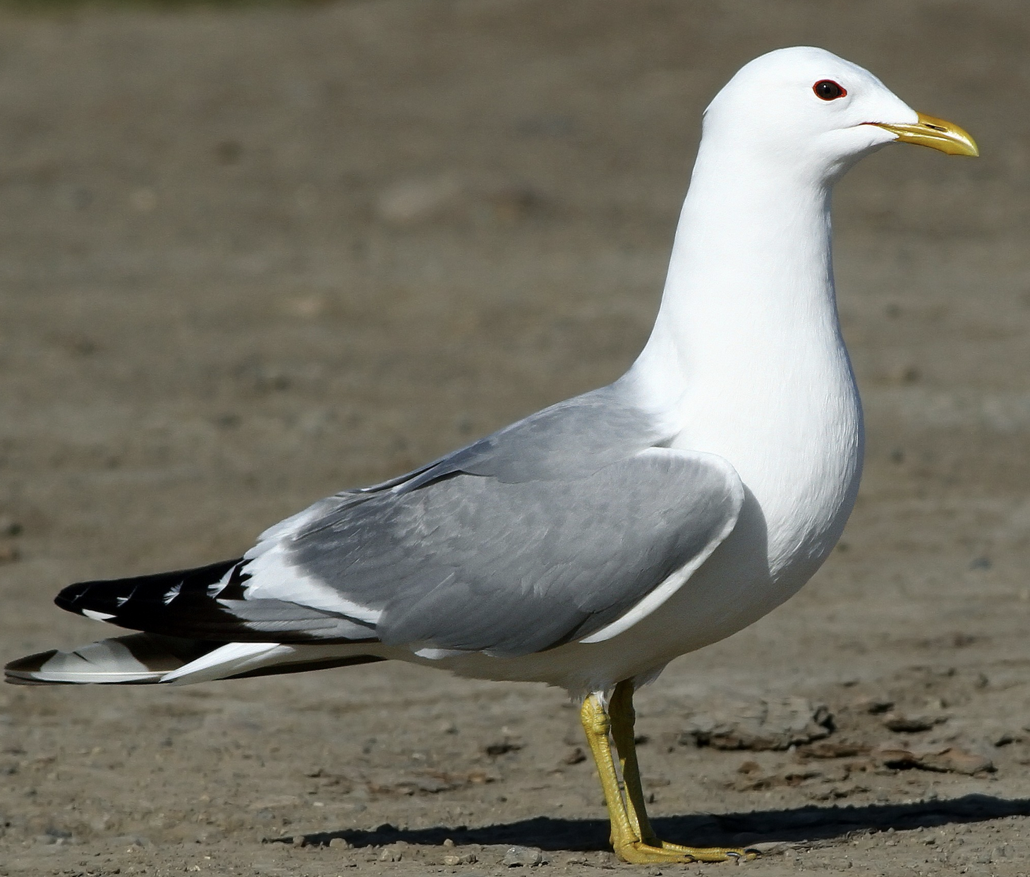
How can I do it?
Let's figure that out!
richard@birdinginvermont.com
richard.social
Thanks!
Ps Short-billed Gull

